Slide 1
SPRFMO experiences with management areas and stock definitions and some chub mackerel assessments in the East Sea
Alaska Fisheries
Science Center
Jim Ianelli
Resource Ecology and Fisheries Management
Alaska Fisheries Science Center
NMFS NOAA
May 16 2017

Slide 2
Outline
Plan for integrating climate forcing of Bond

Slide 3
Activities during the May 2015 work
Specify control rules
Korean Tier 2
No fishing alternative (for contrast)
Alternative future recruitment scenarios;
Based on projected variability in salinity (and maybe temperature)
Spawning biomass as part of recruitment function
Examine option of setting SRR based on Fmsy = F_{35%}

Slide 4
Chub mackerel catch time series uncertainty

Slide 5
Year/catch | Korea | Japan-Tsushima | Japan-Pacific | China(FAO) |  | Year/catch | Korea | Japan-Tsushima | Japan-Pacific | China(FAO)
1950 | 14,436 |  |  | 27,200 |  | 1983 | 122,883 | 242,000 | 391,471 | 153,932
1951 | 18,918 |  |  | 39,200 |  | 1984 | 101,714 | 198,000 | 557,086 | 123,933
1952 | 19,782 |  |  | 49,600 |  | 1985 | 68,479 | 204,000 | 448,438 | 92,573
1953 | 12,971 |  |  | 50,400 |  | 1986 | 103,511 | 193,000 | 640,616 | 132,196
1954 | 26,516 |  |  | 61,400 |  | 1987 | 101,337 | 194,000 | 348,773 | 166,039
1955 | 16,667 |  |  | 67,100 |  | 1988 | 162,828 | 240,000 | 271,925 | 240,699
1956 | 15,700 |  |  | 78,000 |  | 1989 | 163,617 | 283,000 | 134,014 | 231,625
1957 | 12,788 |  |  | 76,000 |  | 1990 | 97,227 | 131,000 | 24,013 | 196,823
1958 | 5,793 |  |  | 76,000 |  | 1991 | 91,538 | 153,000 | 22,872 | 242,639
1959 | 1,634 |  |  | 80,000 |  | 1992 | 116,422 | 143,000 | 83,898 | 243,143
1960 | 2,175 | 3,090 | 1,313 | 80,000 |  | 1993 | 174,684 | 235,000 | 404,822 | 272,604
1961 | 1,762 | 2,503 | 8,614 | 80,000 |  | 1994 | 210,442 | 339,000 | 117,863 | 336,095
1962 | 4,058 | 5,765 | 6,685 | 84,000 |  | 1995 | 200,481 | 208,000 | 146,270 | 372,038
1963 | 5,406 | 7,680 | 17,626 | 84,000 |  | 1996 | 415,003 | 411,000 | 267,194 | 374,400
1964 | 2,441 | 3,468 | 151,420 | 84,000 |  | 1997 | 160,448 | 211,000 | 334,748 | 377,940
1965 | 7,339 | 10,426 | 274,321 | 88,000 |  | 1998 | 172,925 | 165,000 | 113,258 | 341,390
1966 | 2,078 | 2,952 | 334,962 | 88,000 |  | 1999 | 177,540 | 108,000 | 70,222 | 349,154
1967 | 2,772 | 3,938 | 462,310 | 88,000 |  | 2000 | 145,908 | 89,000 | 93,707 | 300,962
1968 | 10,481 | 14,890 | 617,342 | 92,000 |  | 2001 | 203,717 | 78,000 | 55,812 | 325,563
1969 | 42,103 | 59,813 | 568,918 | 92,000 |  | 2002 | 141,751 | 86,000 | 48,192 | 353,400
1970 | 38,256 | 54,347 | 862,536 | 173,100 |  | 2003 | 122,044 | 83,000 | 76,696 | 370,747
1971 | 60,599 | 86,089 | 870,326 | 36,600 |  | 2004 | 184,274 | 85,000 | 180,667 | 382,927
1972 | 78,969 |  | 867,232 | 78,300 |  | 2005 | 135,596 | 92,000 | 226,521 | 419,002
1973 | 74,150 | 269,000 | 842,788 | 93,100 |  | 2006 | 101,427 | 91,000 | 238,989 | 403,510
1974 | 80,649 | 347,000 | 902,798 | 113,547 |  | 2007 | 143,776 | 106,000 | 182,148 | 343,821
1975 | 70,123 | 290,000 | 918,917 | 84,487 |  | 2008 | 187,240 | 121,000 | 173,401 | 592,637
1976 | 107,382 | 269,000 | 707,857 | 78,965 |  | 2009 | 117,960 | 131,000 | 127,223 | 397,010
1977 | 113,051 | 292,000 | 1,095,830 | 134,852 |  | 2010 | 94,331 | 116,000 | 131,000 | 494,691
1978 | 99,519 | 298,000 | 1,474,434 | 282,262 |  | 2011 | 151,800 | 115,000 | 103,000 | 573,458
1979 | 120,283 | 270,000 | 1,307,310 | 111,637 |  | 2012 | 125,144 | 108,000 | 120,000 | 400,000
1980 | 62,690 | 297,000 | 636,826 | 83,760 |  | 2013 | 115,427 | 64,000 | 220,000 | 400,000
1981 | 108,082 | 244,000 | 390,203 | 73,466 |  | 2014 | 130,790 | 95,667 | 147,667 | 457,819
1982 | 99,447 | 281,000 | 356,984 | 107,005
Notes:
Core data for VPA (Base model data)

Slide 6
VPA Catch Option
Year/catch | Korea | Japan-Tsushima | Japan-Pacific | China(FAO) |  | Year/catch | Korea | Japan-Tsushima | Japan-Pacific | China(FAO)
1950 | 14,436 |  |  | 27,200 |  | 1983 | 122,883 | 242,000 | 391,471 | 153,932
1951 | 18,918 |  |  | 39,200 |  | 1984 | 101,714 | 198,000 | 557,086 | 123,933
1952 | 19,782 |  |  | 49,600 |  | 1985 | 68,479 | 204,000 | 448,438 | 92,573
1953 | 12,971 |  |  | 50,400 |  | 1986 | 103,511 | 193,000 | 640,616 | 132,196
1954 | 26,516 |  |  | 61,400 |  | 1987 | 101,337 | 194,000 | 348,773 | 166,039
1955 | 16,667 |  |  | 67,100 |  | 1988 | 162,828 | 240,000 | 271,925 | 240,699
1956 | 15,700 |  |  | 78,000 |  | 1989 | 163,617 | 283,000 | 134,014 | 231,625
1957 | 12,788 |  |  | 76,000 |  | 1990 | 97,227 | 131,000 | 24,013 | 196,823
1958 | 5,793 |  |  | 76,000 |  | 1991 | 91,538 | 153,000 | 22,872 | 242,639
1959 | 1,634 |  |  | 80,000 |  | 1992 | 116,422 | 143,000 | 83,898 | 243,143
1960 | 2,175 | 3,090 | 1,313 | 80,000 |  | 1993 | 174,684 | 235,000 | 404,822 | 272,604
1961 | 1,762 | 2,503 | 8,614 | 80,000 |  | 1994 | 210,442 | 339,000 | 117,863 | 336,095
1962 | 4,058 | 5,765 | 6,685 | 84,000 |  | 1995 | 200,481 | 208,000 | 146,270 | 372,038
1963 | 5,406 | 7,680 | 17,626 | 84,000 |  | 1996 | 415,003 | 411,000 | 267,194 | 374,400
1964 | 2,441 | 3,468 | 151,420 | 84,000 |  | 1997 | 160,448 | 211,000 | 334,748 | 377,940
1965 | 7,339 | 10,426 | 274,321 | 88,000 |  | 1998 | 172,925 | 165,000 | 113,258 | 341,390
1966 | 2,078 | 2,952 | 334,962 | 88,000 |  | 1999 | 177,540 | 108,000 | 70,222 | 349,154
1967 | 2,772 | 3,938 | 462,310 | 88,000 |  | 2000 | 145,908 | 89,000 | 93,707 | 300,962
1968 | 10,481 | 14,890 | 617,342 | 92,000 |  | 2001 | 203,717 | 78,000 | 55,812 | 325,563
1969 | 42,103 | 59,813 | 568,918 | 92,000 |  | 2002 | 141,751 | 86,000 | 48,192 | 353,400
1970 | 38,256 | 54,347 | 862,536 | 173,100 |  | 2003 | 122,044 | 83,000 | 76,696 | 370,747
1971 | 60,599 | 86,089 | 870,326 | 36,600 |  | 2004 | 184,274 | 85,000 | 180,667 | 382,927
1972 | 78,969 |  | 867,232 | 78,300 |  | 2005 | 135,596 | 92,000 | 226,521 | 419,002
1973 | 74,150 | 269,000 | 842,788 | 93,100 |  | 2006 | 101,427 | 91,000 | 238,989 | 403,510
1974 | 80,649 | 347,000 | 902,798 | 113,547 |  | 2007 | 143,776 | 106,000 | 182,148 | 343,821
1975 | 70,123 | 290,000 | 918,917 | 84,487 |  | 2008 | 187,240 | 121,000 | 173,401 | 592,637
1976 | 107,382 | 269,000 | 707,857 | 78,965 |  | 2009 | 117,960 | 131,000 | 127,223 | 397,010
1977 | 113,051 | 292,000 | 1,095,830 | 134,852 |  | 2010 | 94,331 | 116,000 | 131,000 | 494,691
1978 | 99,519 | 298,000 | 1,474,434 | 282,262 |  | 2011 | 151,800 | 115,000 | 103,000 | 573,458
1979 | 120,283 | 270,000 | 1,307,310 | 111,637 |  | 2012 | 125,144 | 108,000 | 120,000 | 400,000
1980 | 62,690 | 297,000 | 636,826 | 83,760 |  | 2013 | 115,427 | 64,000 | 220,000 | 400,000
1981 | 108,082 | 244,000 | 390,203 | 73,466 |  | 2014 | 130,790 | 95,667 | 147,667 | 457,819
1982 | 99,447 | 281,000 | 356,984 | 107,005

Slide 7
Year/catch | Korea | Japan-Tsushima | Japan-Pacific | China(FAO) |  | Year/catch | Korea | Japan-Tsushima | Japan-Pacific | China(FAO)
1950 | 14,436 |  |  | 27,200 |  | 1983 | 122,883 | 242,000 | 391,471 | 153,932
1951 | 18,918 |  |  | 39,200 |  | 1984 | 101,714 | 198,000 | 557,086 | 123,933
1952 | 19,782 |  |  | 49,600 |  | 1985 | 68,479 | 204,000 | 448,438 | 92,573
1953 | 12,971 |  |  | 50,400 |  | 1986 | 103,511 | 193,000 | 640,616 | 132,196
1954 | 26,516 |  |  | 61,400 |  | 1987 | 101,337 | 194,000 | 348,773 | 166,039
1955 | 16,667 |  |  | 67,100 |  | 1988 | 162,828 | 240,000 | 271,925 | 240,699
1956 | 15,700 |  |  | 78,000 |  | 1989 | 163,617 | 283,000 | 134,014 | 231,625
1957 | 12,788 |  |  | 76,000 |  | 1990 | 97,227 | 131,000 | 24,013 | 196,823
1958 | 5,793 |  |  | 76,000 |  | 1991 | 91,538 | 153,000 | 22,872 | 242,639
1959 | 1,634 |  |  | 80,000 |  | 1992 | 116,422 | 143,000 | 83,898 | 243,143
1960 | 2,175 | 3,090 | 1,313 | 80,000 |  | 1993 | 174,684 | 235,000 | 404,822 | 272,604
1961 | 1,762 | 2,503 | 8,614 | 80,000 |  | 1994 | 210,442 | 339,000 | 117,863 | 336,095
1962 | 4,058 | 5,765 | 6,685 | 84,000 |  | 1995 | 200,481 | 208,000 | 146,270 | 372,038
1963 | 5,406 | 7,680 | 17,626 | 84,000 |  | 1996 | 415,003 | 411,000 | 267,194 | 374,400
1964 | 2,441 | 3,468 | 151,420 | 84,000 |  | 1997 | 160,448 | 211,000 | 334,748 | 377,940
1965 | 7,339 | 10,426 | 274,321 | 88,000 |  | 1998 | 172,925 | 165,000 | 113,258 | 341,390
1966 | 2,078 | 2,952 | 334,962 | 88,000 |  | 1999 | 177,540 | 108,000 | 70,222 | 349,154
1967 | 2,772 | 3,938 | 462,310 | 88,000 |  | 2000 | 145,908 | 89,000 | 93,707 | 300,962
1968 | 10,481 | 14,890 | 617,342 | 92,000 |  | 2001 | 203,717 | 78,000 | 55,812 | 325,563
1969 | 42,103 | 59,813 | 568,918 | 92,000 |  | 2002 | 141,751 | 86,000 | 48,192 | 353,400
1970 | 38,256 | 54,347 | 862,536 | 173,100 |  | 2003 | 122,044 | 83,000 | 76,696 | 370,747
1971 | 60,599 | 86,089 | 870,326 | 36,600 |  | 2004 | 184,274 | 85,000 | 180,667 | 382,927
1972 | 78,969 |  | 867,232 | 78,300 |  | 2005 | 135,596 | 92,000 | 226,521 | 419,002
1973 | 74,150 | 269,000 | 842,788 | 93,100 |  | 2006 | 101,427 | 91,000 | 238,989 | 403,510
1974 | 80,649 | 347,000 | 902,798 | 113,547 |  | 2007 | 143,776 | 106,000 | 182,148 | 343,821
1975 | 70,123 | 290,000 | 918,917 | 84,487 |  | 2008 | 187,240 | 121,000 | 173,401 | 592,637
1976 | 107,382 | 269,000 | 707,857 | 78,965 |  | 2009 | 117,960 | 131,000 | 127,223 | 397,010
1977 | 113,051 | 292,000 | 1,095,830 | 134,852 |  | 2010 | 94,331 | 116,000 | 131,000 | 494,691
1978 | 99,519 | 298,000 | 1,474,434 | 282,262 |  | 2011 | 151,800 | 115,000 | 103,000 | 573,458
1979 | 120,283 | 270,000 | 1,307,310 | 111,637 |  | 2012 | 125,144 | 108,000 | 120,000 | 400,000
1980 | 62,690 | 297,000 | 636,826 | 83,760 |  | 2013 | 115,427 | 64,000 | 220,000 | 400,000
1981 | 108,082 | 244,000 | 390,203 | 73,466 |  | 2014 | 130,790 | 95,667 | 147,667 | 457,819
1982 | 99,447 | 281,000 | 356,984 | 107,005

Slide 8
Year/catch | Korea | Japan-Tsushima | Japan-Pacific | China(FAO) |  | Year/catch | Korea | Japan-Tsushima | Japan-Pacific | China(FAO)
1950 | 14,436 |  |  | 27,200 |  | 1983 | 122,883 | 242,000 | 391,471 | 153,932
1951 | 18,918 |  |  | 39,200 |  | 1984 | 101,714 | 198,000 | 557,086 | 123,933
1952 | 19,782 |  |  | 49,600 |  | 1985 | 68,479 | 204,000 | 448,438 | 92,573
1953 | 12,971 |  |  | 50,400 |  | 1986 | 103,511 | 193,000 | 640,616 | 132,196
1954 | 26,516 |  |  | 61,400 |  | 1987 | 101,337 | 194,000 | 348,773 | 166,039
1955 | 16,667 |  |  | 67,100 |  | 1988 | 162,828 | 240,000 | 271,925 | 240,699
1956 | 15,700 |  |  | 78,000 |  | 1989 | 163,617 | 283,000 | 134,014 | 231,625
1957 | 12,788 |  |  | 76,000 |  | 1990 | 97,227 | 131,000 | 24,013 | 196,823
1958 | 5,793 |  |  | 76,000 |  | 1991 | 91,538 | 153,000 | 22,872 | 242,639
1959 | 1,634 |  |  | 80,000 |  | 1992 | 116,422 | 143,000 | 83,898 | 243,143
1960 | 2,175 | 3,090 | 1,313 | 80,000 |  | 1993 | 174,684 | 235,000 | 404,822 | 272,604
1961 | 1,762 | 2,503 | 8,614 | 80,000 |  | 1994 | 210,442 | 339,000 | 117,863 | 336,095
1962 | 4,058 | 5,765 | 6,685 | 84,000 |  | 1995 | 200,481 | 208,000 | 146,270 | 372,038
1963 | 5,406 | 7,680 | 17,626 | 84,000 |  | 1996 | 415,003 | 411,000 | 267,194 | 374,400
1964 | 2,441 | 3,468 | 151,420 | 84,000 |  | 1997 | 160,448 | 211,000 | 334,748 | 377,940
1965 | 7,339 | 10,426 | 274,321 | 88,000 |  | 1998 | 172,925 | 165,000 | 113,258 | 341,390
1966 | 2,078 | 2,952 | 334,962 | 88,000 |  | 1999 | 177,540 | 108,000 | 70,222 | 349,154
1967 | 2,772 | 3,938 | 462,310 | 88,000 |  | 2000 | 145,908 | 89,000 | 93,707 | 300,962
1968 | 10,481 | 14,890 | 617,342 | 92,000 |  | 2001 | 203,717 | 78,000 | 55,812 | 325,563
1969 | 42,103 | 59,813 | 568,918 | 92,000 |  | 2002 | 141,751 | 86,000 | 48,192 | 353,400
1970 | 38,256 | 54,347 | 862,536 | 173,100 |  | 2003 | 122,044 | 83,000 | 76,696 | 370,747
1971 | 60,599 | 86,089 | 870,326 | 36,600 |  | 2004 | 184,274 | 85,000 | 180,667 | 382,927
1972 | 78,969 |  | 867,232 | 78,300 |  | 2005 | 135,596 | 92,000 | 226,521 | 419,002
1973 | 74,150 | 269,000 | 842,788 | 93,100 |  | 2006 | 101,427 | 91,000 | 238,989 | 403,510
1974 | 80,649 | 347,000 | 902,798 | 113,547 |  | 2007 | 143,776 | 106,000 | 182,148 | 343,821
1975 | 70,123 | 290,000 | 918,917 | 84,487 |  | 2008 | 187,240 | 121,000 | 173,401 | 592,637
1976 | 107,382 | 269,000 | 707,857 | 78,965 |  | 2009 | 117,960 | 131,000 | 127,223 | 397,010
1977 | 113,051 | 292,000 | 1,095,830 | 134,852 |  | 2010 | 94,331 | 116,000 | 131,000 | 494,691
1978 | 99,519 | 298,000 | 1,474,434 | 282,262 |  | 2011 | 151,800 | 115,000 | 103,000 | 573,458
1979 | 120,283 | 270,000 | 1,307,310 | 111,637 |  | 2012 | 125,144 | 108,000 | 120,000 | 400,000
1980 | 62,690 | 297,000 | 636,826 | 83,760 |  | 2013 | 115,427 | 64,000 | 220,000 | 400,000
1981 | 108,082 | 244,000 | 390,203 | 73,466 |  | 2014 | 130,790 | 95,667 | 147,667 | 457,819
1982 | 99,447 | 281,000 | 356,984 | 107,005

Slide 9
Year/catch | Korea | Japan-Tsushima | Japan-Pacific | China(FAO) |  | Year/catch | Korea | Japan-Tsushima | Japan-Pacific | China(FAO)
1950 | 14,436 | 20,508 |  | 27,200 |  | 1983 | 122,883 | 242,000 | 391,471 | 153,932
1951 | 18,918 | 26,875 |  | 39,200 |  | 1984 | 101,714 | 198,000 | 557,086 | 123,933
1952 | 19,782 | 28,103 |  | 49,600 |  | 1985 | 68,479 | 204,000 | 448,438 | 92,573
1953 | 12,971 | 18,427 |  | 50,400 |  | 1986 | 103,511 | 193,000 | 640,616 | 132,196
1954 | 26,516 | 37,669 |  | 61,400 |  | 1987 | 101,337 | 194,000 | 348,773 | 166,039
1955 | 16,667 | 23,678 |  | 67,100 |  | 1988 | 162,828 | 240,000 | 271,925 | 240,699
1956 | 15,700 | 22,304 |  | 78,000 |  | 1989 | 163,617 | 283,000 | 134,014 | 231,625
1957 | 12,788 | 18,167 |  | 76,000 |  | 1990 | 97,227 | 131,000 | 24,013 | 196,823
1958 | 5,793 | 8,230 |  | 76,000 |  | 1991 | 91,538 | 153,000 | 22,872 | 242,639
1959 | 1,634 | 2,321 |  | 80,000 |  | 1992 | 116,422 | 143,000 | 83,898 | 243,143
1960 | 2,175 | 3,090 | 1,313 | 80,000 |  | 1993 | 174,684 | 235,000 | 404,822 | 272,604
1961 | 1,762 | 2,503 | 8,614 | 80,000 |  | 1994 | 210,442 | 339,000 | 117,863 | 336,095
1962 | 4,058 | 5,765 | 6,685 | 84,000 |  | 1995 | 200,481 | 208,000 | 146,270 | 372,038
1963 | 5,406 | 7,680 | 17,626 | 84,000 |  | 1996 | 415,003 | 411,000 | 267,194 | 374,400
1964 | 2,441 | 3,468 | 151,420 | 84,000 |  | 1997 | 160,448 | 211,000 | 334,748 | 377,940
1965 | 7,339 | 10,426 | 274,321 | 88,000 |  | 1998 | 172,925 | 165,000 | 113,258 | 341,390
1966 | 2,078 | 2,952 | 334,962 | 88,000 |  | 1999 | 177,540 | 108,000 | 70,222 | 349,154
1967 | 2,772 | 3,938 | 462,310 | 88,000 |  | 2000 | 145,908 | 89,000 | 93,707 | 300,962
1968 | 10,481 | 14,890 | 617,342 | 92,000 |  | 2001 | 203,717 | 78,000 | 55,812 | 325,563
1969 | 42,103 | 59,813 | 568,918 | 92,000 |  | 2002 | 141,751 | 86,000 | 48,192 | 353,400
1970 | 38,256 | 54,347 | 862,536 | 173,100 |  | 2003 | 122,044 | 83,000 | 76,696 | 370,747
1971 | 60,599 | 86,089 | 870,326 | 36,600 |  | 2004 | 184,274 | 85,000 | 180,667 | 382,927
1972 | 78,969 | 112,185 | 867,232 | 78,300 |  | 2005 | 135,596 | 92,000 | 226,521 | 419,002
1973 | 74,150 | 269,000 | 842,788 | 93,100 |  | 2006 | 101,427 | 91,000 | 238,989 | 403,510
1974 | 80,649 | 347,000 | 902,798 | 113,547 |  | 2007 | 143,776 | 106,000 | 182,148 | 343,821
1975 | 70,123 | 290,000 | 918,917 | 84,487 |  | 2008 | 187,240 | 121,000 | 173,401 | 592,637
1976 | 107,382 | 269,000 | 707,857 | 78,965 |  | 2009 | 117,960 | 131,000 | 127,223 | 397,010
1977 | 113,051 | 292,000 | 1,095,830 | 134,852 |  | 2010 | 94,331 | 116,000 | 131,000 | 494,691
1978 | 99,519 | 298,000 | 1,474,434 | 282,262 |  | 2011 | 151,800 | 115,000 | 103,000 | 573,458
1979 | 120,283 | 270,000 | 1,307,310 | 111,637 |  | 2012 | 125,144 | 108,000 | 120,000 | 400,000
1980 | 62,690 | 297,000 | 636,826 | 83,760 |  | 2013 | 115,427 | 64,000 | 220,000 | 400,000
1981 | 108,082 | 244,000 | 390,203 | 73,466 |  | 2014 | 130,790 | 95,667 | 147,667 | 457,819
1982 | 99,447 | 281,000 | 356,984 | 107,005

Slide 10
Catch option 1
Year/catch | Korea | Japan-Tsushima | Japan-Pacific | China(FAO) |  | Year/catch | Korea | Japan-Tsushima | Japan-Pacific | China(FAO)
1950 | 14,436 | 20,508 |  | 27,200 |  | 1983 | 122,883 | 242,000 | 391,471 | 153,932
1951 | 18,918 | 26,875 |  | 39,200 |  | 1984 | 101,714 | 198,000 | 557,086 | 123,933
1952 | 19,782 | 28,103 |  | 49,600 |  | 1985 | 68,479 | 204,000 | 448,438 | 92,573
1953 | 12,971 | 18,427 |  | 50,400 |  | 1986 | 103,511 | 193,000 | 640,616 | 132,196
1954 | 26,516 | 37,669 |  | 61,400 |  | 1987 | 101,337 | 194,000 | 348,773 | 166,039
1955 | 16,667 | 23,678 |  | 67,100 |  | 1988 | 162,828 | 240,000 | 271,925 | 240,699
1956 | 15,700 | 22,304 |  | 78,000 |  | 1989 | 163,617 | 283,000 | 134,014 | 231,625
1957 | 12,788 | 18,167 |  | 76,000 |  | 1990 | 97,227 | 131,000 | 24,013 | 196,823
1958 | 5,793 | 8,230 |  | 76,000 |  | 1991 | 91,538 | 153,000 | 22,872 | 242,639
1959 | 1,634 | 2,321 |  | 80,000 |  | 1992 | 116,422 | 143,000 | 83,898 | 243,143
1960 | 2,175 | 3,090 | 1,313 | 80,000 |  | 1993 | 174,684 | 235,000 | 404,822 | 272,604
1961 | 1,762 | 2,503 | 8,614 | 80,000 |  | 1994 | 210,442 | 339,000 | 117,863 | 336,095
1962 | 4,058 | 5,765 | 6,685 | 84,000 |  | 1995 | 200,481 | 208,000 | 146,270 | 372,038
1963 | 5,406 | 7,680 | 17,626 | 84,000 |  | 1996 | 415,003 | 411,000 | 267,194 | 374,400
1964 | 2,441 | 3,468 | 151,420 | 84,000 |  | 1997 | 160,448 | 211,000 | 334,748 | 377,940
1965 | 7,339 | 10,426 | 274,321 | 88,000 |  | 1998 | 172,925 | 165,000 | 113,258 | 341,390
1966 | 2,078 | 2,952 | 334,962 | 88,000 |  | 1999 | 177,540 | 108,000 | 70,222 | 349,154
1967 | 2,772 | 3,938 | 462,310 | 88,000 |  | 2000 | 145,908 | 89,000 | 93,707 | 300,962
1968 | 10,481 | 14,890 | 617,342 | 92,000 |  | 2001 | 203,717 | 78,000 | 55,812 | 325,563
1969 | 42,103 | 59,813 | 568,918 | 92,000 |  | 2002 | 141,751 | 86,000 | 48,192 | 353,400
1970 | 38,256 | 54,347 | 862,536 | 173,100 |  | 2003 | 122,044 | 83,000 | 76,696 | 370,747
1971 | 60,599 | 86,089 | 870,326 | 36,600 |  | 2004 | 184,274 | 85,000 | 180,667 | 382,927
1972 | 78,969 | 112,185 | 867,232 | 78,300 |  | 2005 | 135,596 | 92,000 | 226,521 | 419,002
1973 | 74,150 | 269,000 | 842,788 | 93,100 |  | 2006 | 101,427 | 91,000 | 238,989 | 403,510
1974 | 80,649 | 347,000 | 902,798 | 113,547 |  | 2007 | 143,776 | 106,000 | 182,148 | 343,821
1975 | 70,123 | 290,000 | 918,917 | 84,487 |  | 2008 | 187,240 | 121,000 | 173,401 | 592,637
1976 | 107,382 | 269,000 | 707,857 | 78,965 |  | 2009 | 117,960 | 131,000 | 127,223 | 397,010
1977 | 113,051 | 292,000 | 1,095,830 | 134,852 |  | 2010 | 94,331 | 116,000 | 131,000 | 494,691
1978 | 99,519 | 298,000 | 1,474,434 | 282,262 |  | 2011 | 151,800 | 115,000 | 103,000 | 573,458
1979 | 120,283 | 270,000 | 1,307,310 | 111,637 |  | 2012 | 125,144 | 108,000 | 120,000 | 400,000
1980 | 62,690 | 297,000 | 636,826 | 83,760 |  | 2013 | 115,427 | 64,000 | 220,000 | 400,000
1981 | 108,082 | 244,000 | 390,203 | 73,466 |  | 2014 | 130,790 | 95,667 | 147,667 | 457,819
1982 | 99,447 | 281,000 | 356,984 | 107,005

Slide 11
Catch option 2
Year/catch | Korea | Japan-Tsushima | Japan-Pacific | China(FAO) |  | Year/catch | Korea | Japan-Tsushima | Japan-Pacific | China(FAO)
1950 | 14,436 | 20,508 |  | 27,200 |  | 1983 | 122,883 | 242,000 | 391,471 | 153,932
1951 | 18,918 | 26,875 |  | 39,200 |  | 1984 | 101,714 | 198,000 | 557,086 | 123,933
1952 | 19,782 | 28,103 |  | 49,600 |  | 1985 | 68,479 | 204,000 | 448,438 | 92,573
1953 | 12,971 | 18,427 |  | 50,400 |  | 1986 | 103,511 | 193,000 | 640,616 | 132,196
1954 | 26,516 | 37,669 |  | 61,400 |  | 1987 | 101,337 | 194,000 | 348,773 | 166,039
1955 | 16,667 | 23,678 |  | 67,100 |  | 1988 | 162,828 | 240,000 | 271,925 | 240,699
1956 | 15,700 | 22,304 |  | 78,000 |  | 1989 | 163,617 | 283,000 | 134,014 | 231,625
1957 | 12,788 | 18,167 |  | 76,000 |  | 1990 | 97,227 | 131,000 | 24,013 | 196,823
1958 | 5,793 | 8,230 |  | 76,000 |  | 1991 | 91,538 | 153,000 | 22,872 | 242,639
1959 | 1,634 | 2,321 |  | 80,000 |  | 1992 | 116,422 | 143,000 | 83,898 | 243,143
1960 | 2,175 | 3,090 | 1,313 | 80,000 |  | 1993 | 174,684 | 235,000 | 404,822 | 272,604
1961 | 1,762 | 2,503 | 8,614 | 80,000 |  | 1994 | 210,442 | 339,000 | 117,863 | 336,095
1962 | 4,058 | 5,765 | 6,685 | 84,000 |  | 1995 | 200,481 | 208,000 | 146,270 | 372,038
1963 | 5,406 | 7,680 | 17,626 | 84,000 |  | 1996 | 415,003 | 411,000 | 267,194 | 374,400
1964 | 2,441 | 3,468 | 151,420 | 84,000 |  | 1997 | 160,448 | 211,000 | 334,748 | 377,940
1965 | 7,339 | 10,426 | 274,321 | 88,000 |  | 1998 | 172,925 | 165,000 | 113,258 | 341,390
1966 | 2,078 | 2,952 | 334,962 | 88,000 |  | 1999 | 177,540 | 108,000 | 70,222 | 349,154
1967 | 2,772 | 3,938 | 462,310 | 88,000 |  | 2000 | 145,908 | 89,000 | 93,707 | 300,962
1968 | 10,481 | 14,890 | 617,342 | 92,000 |  | 2001 | 203,717 | 78,000 | 55,812 | 325,563
1969 | 42,103 | 59,813 | 568,918 | 92,000 |  | 2002 | 141,751 | 86,000 | 48,192 | 353,400
1970 | 38,256 | 54,347 | 862,536 | 173,100 |  | 2003 | 122,044 | 83,000 | 76,696 | 370,747
1971 | 60,599 | 86,089 | 870,326 | 36,600 |  | 2004 | 184,274 | 85,000 | 180,667 | 382,927
1972 | 78,969 | 112,185 | 867,232 | 78,300 |  | 2005 | 135,596 | 92,000 | 226,521 | 419,002
1973 | 74,150 | 269,000 | 842,788 | 93,100 |  | 2006 | 101,427 | 91,000 | 238,989 | 403,510
1974 | 80,649 | 347,000 | 902,798 | 113,547 |  | 2007 | 143,776 | 106,000 | 182,148 | 343,821
1975 | 70,123 | 290,000 | 918,917 | 84,487 |  | 2008 | 187,240 | 121,000 | 173,401 | 592,637
1976 | 107,382 | 269,000 | 707,857 | 78,965 |  | 2009 | 117,960 | 131,000 | 127,223 | 397,010
1977 | 113,051 | 292,000 | 1,095,830 | 134,852 |  | 2010 | 94,331 | 116,000 | 131,000 | 494,691
1978 | 99,519 | 298,000 | 1,474,434 | 282,262 |  | 2011 | 151,800 | 115,000 | 103,000 | 573,458
1979 | 120,283 | 270,000 | 1,307,310 | 111,637 |  | 2012 | 125,144 | 108,000 | 120,000 | 400,000
1980 | 62,690 | 297,000 | 636,826 | 83,760 |  | 2013 | 115,427 | 64,000 | 220,000 | 400,000
1981 | 108,082 | 244,000 | 390,203 | 73,466 |  | 2014 | 130,790 | 95,667 | 147,667 | 457,819
1982 | 99,447 | 281,000 | 356,984 | 107,005

Slide 15
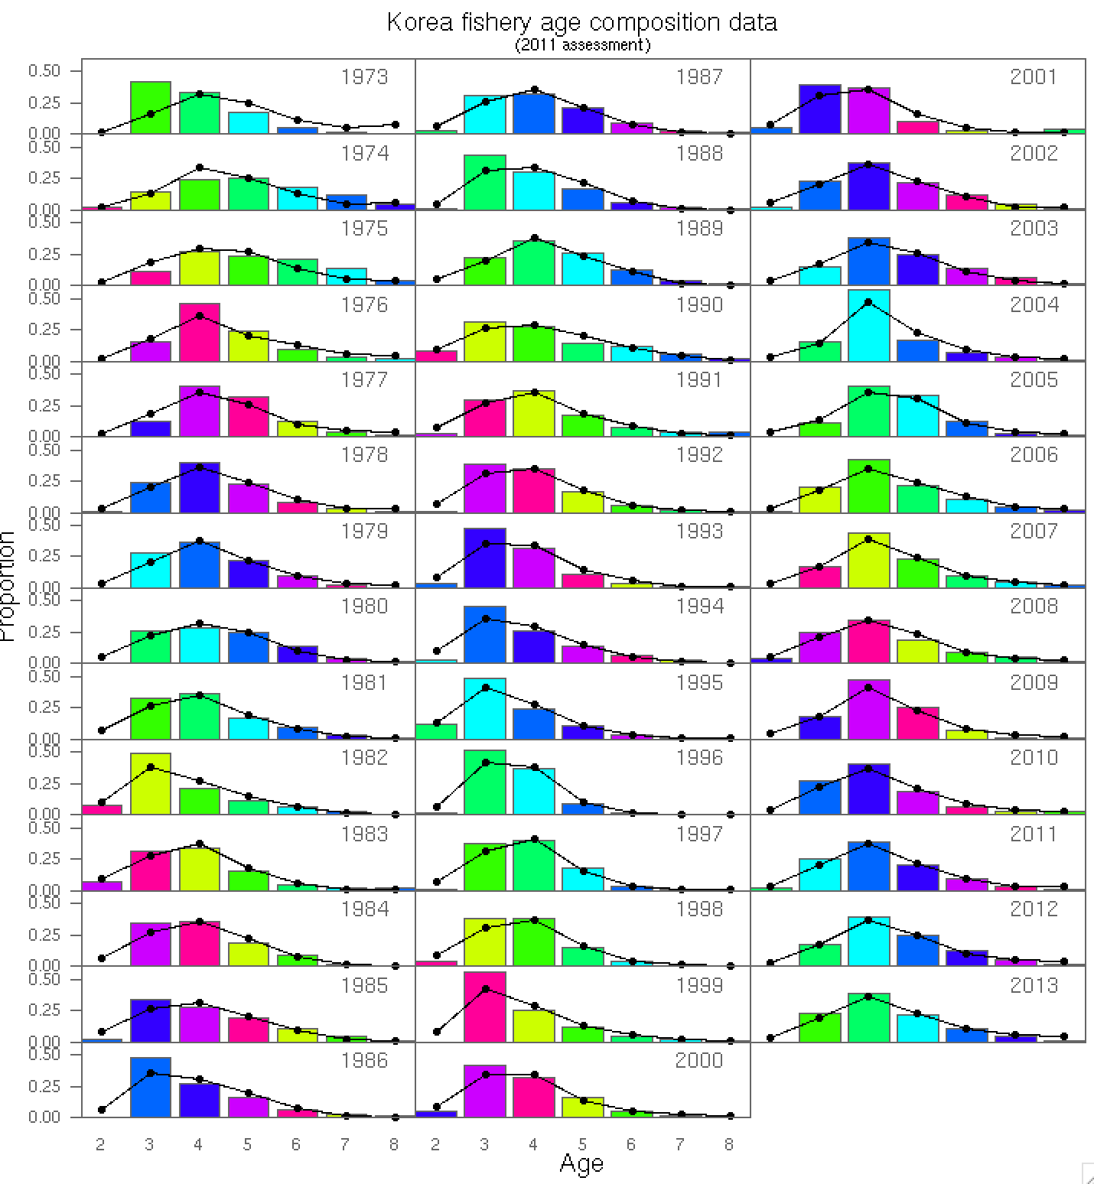
Fit to Fishery age

Slide 16
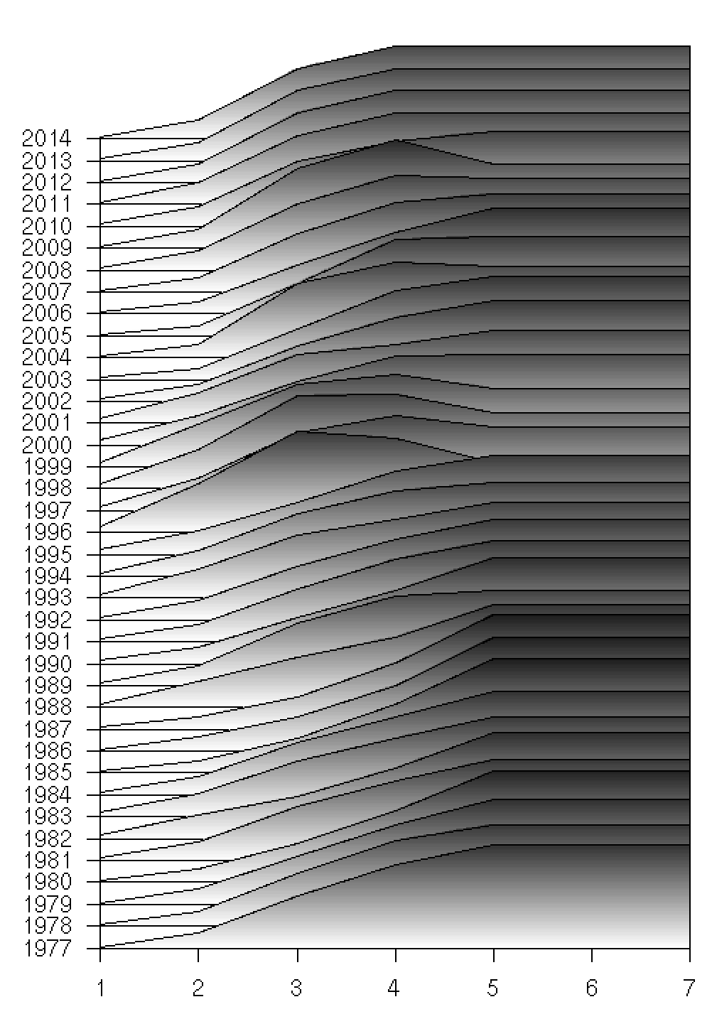
Fit to CPUE and fishery selectivity
Year
Age
Notes:
Age

Slide 20
Model with Pacific and Chinese catch included

Slide 21
Model with East Sea catches only

Slide 22
Model with East Sea catches only, alternative CPUE

Slide 23
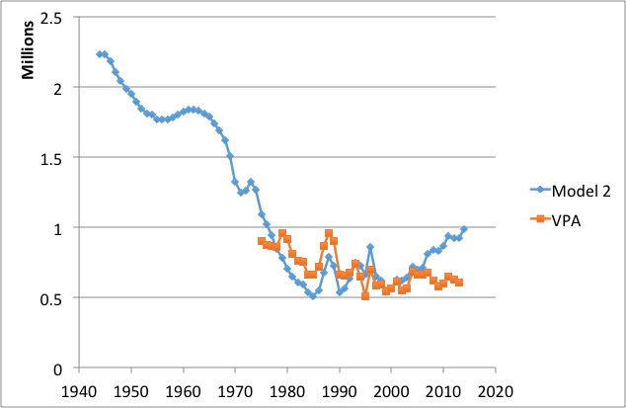
Indicative preliminary results

